Slide 1


Machine Learning and Fair Lending
EXPLORING MACHINE LEARNING DE-BIASING TECHNIQUES

Slide 2
TABLE OF CONTENTS
Project Overview
Important Definitions
Project Importance
2022 HMDA Dataset Exploration
Machine Learning Model Selection
Machine Learning De-Biasing Techniques
Conclusion & Recommendations
Appendix

Slide 3
EXECUTIVE SUMMARY – PROJECT GOALS
Analyze the 2022 HMDA (Home Mortgage Disclosure Act) for fair lending violations
Build Power BI dashboards displaying Approval & Denial Rates and High-Interest Loans
Build machine learning models that accurately model outcomes in the HMDA dataset
Approval & Denial
High-Interest Loan
Identify sources of algorithmic bias in the model
Use de-biasing techniques and measure their effect on model accuracy

Slide 4
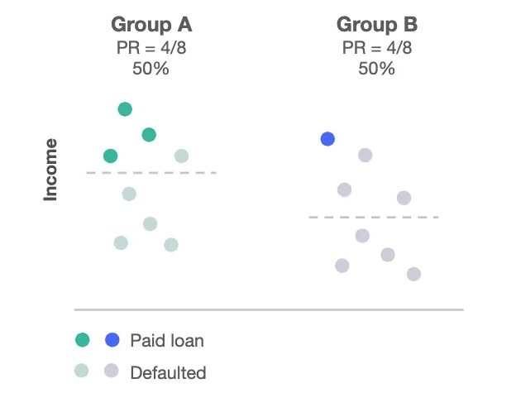
IMPORTANT DEFINITIONS – FAIRNESS
Mathematical Fairness - Demographic Parity
The proportion of each segment of a protected class should receive the positive outcome at equal rates
Detection of historical biases may have affected the quality of our data
Fig 1 *

Slide 5
IMPORTANT DEFINITIONS – ADVERSE IMPACT RATIO (AIR)
AIR is a measure used to evaluate whether there is a significant difference in outcomes among different demographic groups.
Calculation:
Selection Rate
For Minority Group
20%
0.5
Selection Rate
For Majority Group
40%
An AIR value less than 1 suggests that the minority group is selected at a lower rate than the majority group. Values closer to 1 indicate less disparity. A common threshold for identifying potential discrimination is an AIR value of less than 0.8, as suggested by the U.S. Equal Employment Opportunity Commission (EEOC).

Slide 6
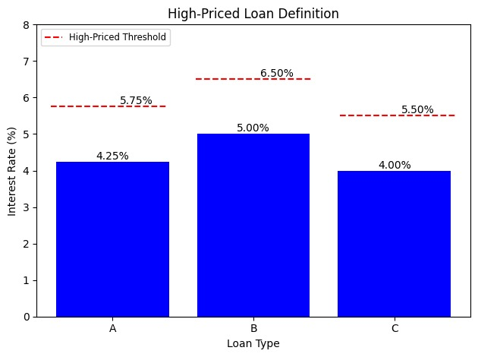
IMPORTANT DEFINITIONS – HIGH PRICED LOAN
A loan is considered high-priced if its interest rate is more than 1.5% above the average rate for a specific loan type.
Example:
If the average interest rate for a conventional loan is 4.25%, and an individual secures a loan at 5.75%, it would be categorized as a high-priced loan.
Fig 2

Slide 7
WHY DOES THIS PROJECT MATTER?
Applicant Group | Average Interest Rate | Monthly Payment | Total Cost Over Years ($) | Loan Monetary Difference ($) | Total Loans In The 2022 Dataset | Total Monetary Difference ($)
Asian | 4.59% | $ 1,536 | $ 553,010 | $ 0 | ~ 487,000 | $ 0
White | 4.77% | $ 1,568 | $ 564,681 | $ 11,671 | ~ 4,800,000 | $ ~ 56 Bn
Black or African American | 4.99% | $ 1,608 | $ 579,107 | $ 26,096 | ~ 450,000 | $ ~ 11.7 Bn
American Indian or Alaska Native | 5.11% | $ 1,630 | $ 587,050 | $ 34,038 | ~ 134,000 | $ ~ 4.5 Bn
Hispanic | 5.16% | $ 1,640 | $ 590,374 | $ 37,363 | ~ 40,000 | $ ~ 1.5 Bn
In the table above, we assume a 30-year fixed-rate mortgage of $300,000.
The 2022 HMDA dataset contains around 7.3 million approved conventional loans.

Slide 8
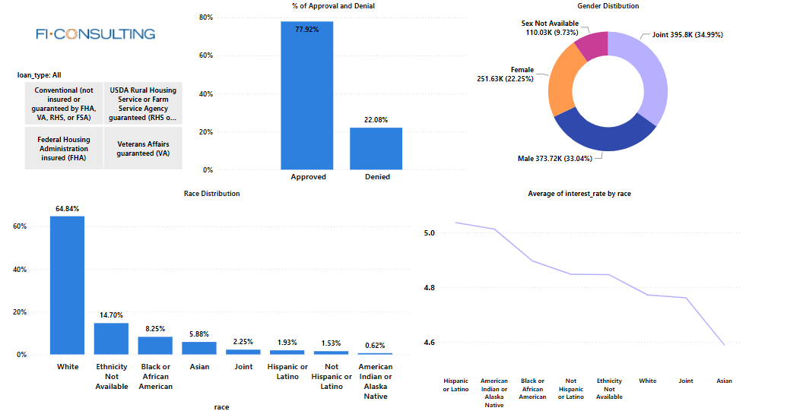
EXPLORATORY ANALYSIS – DATA OVERVIEW

Slide 9
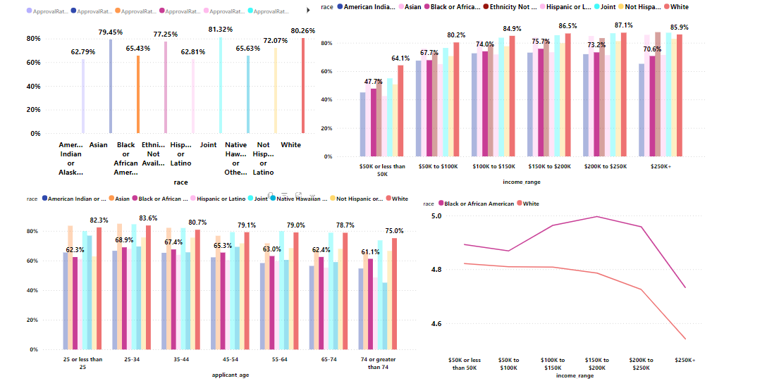
EXPLORATORY ANALYSIS – APPROVAL RATES

Slide 10
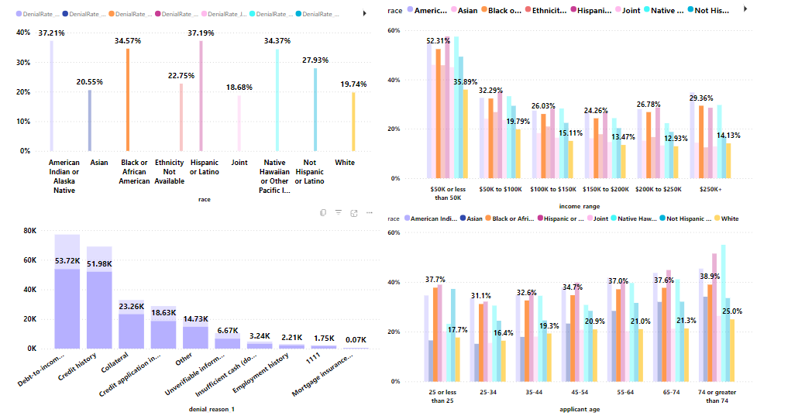
EXPLORATORY ANALYSIS – DENIAL RATES

Slide 11
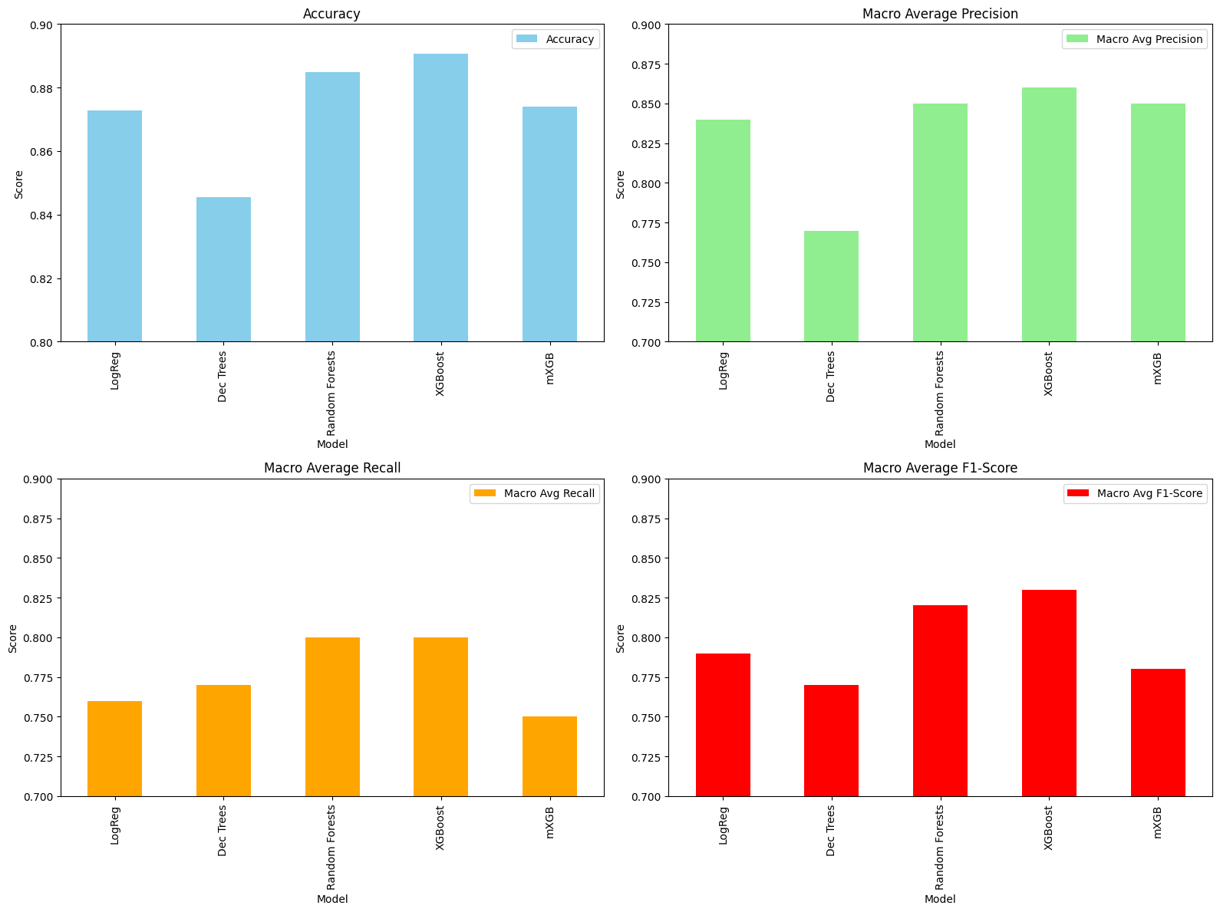
XGB MODEL – APPROVAL & DENIAL
Model Performance
Accuracy: 0.89
Precision
Approval: 0.81
Denial: 0.91
Recall
Approval: 0.65
Denial: 0.96
F1 Score
Approval: 0.72
Denial: 0.93
Fig 3

Slide 12
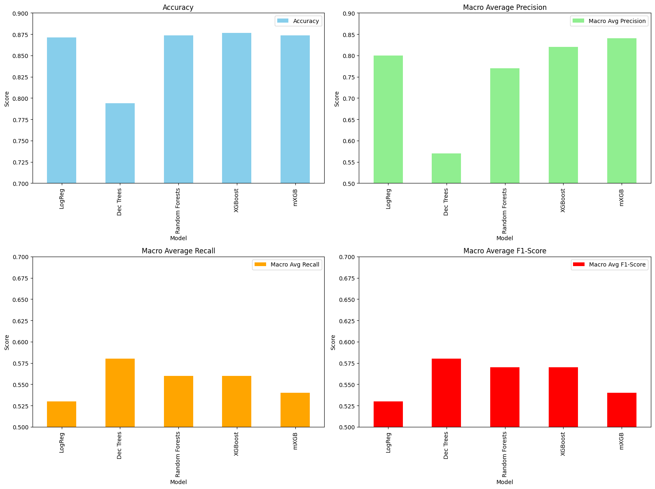
XGB MODEL – HIGH INTEREST LOAN
Model Performance
Accuracy: 0.88
Precision
High Interest: 0.88
Not High Interest: 0.76
Recall
High Interest: 0.99
Not High Interest: 0.12
F1 Score
High Interest: 0.93
Not High Interest: 0.21
Fig 4

Slide 13
MACHINE LEARNING DE-BIASING TECHNIQUES
Pre-Processing
Involves cleaning, organizing, and transforming raw data into a suitable format for efficient and effective model training
In-Processing
integrating fairness or bias mitigation techniques directly into the learning algorithm to ensure more equitable outcomes during model training
Post-Processing
involves adjusting or correcting the model's predictions after training, often to enhance performance, interpretability, or fairness before deployment
Feature Selection
Involves identifying and selecting a subset of relevant features for use in model construction, aiming to improve model performance, reduce overfitting, and decrease training time
Hyperparameter Tuning
Involves systematically searching for the optimal set of hyperparameters that governs the learning process and architecture of a machine learning model to maximize its performance on a given dataset

Slide 14
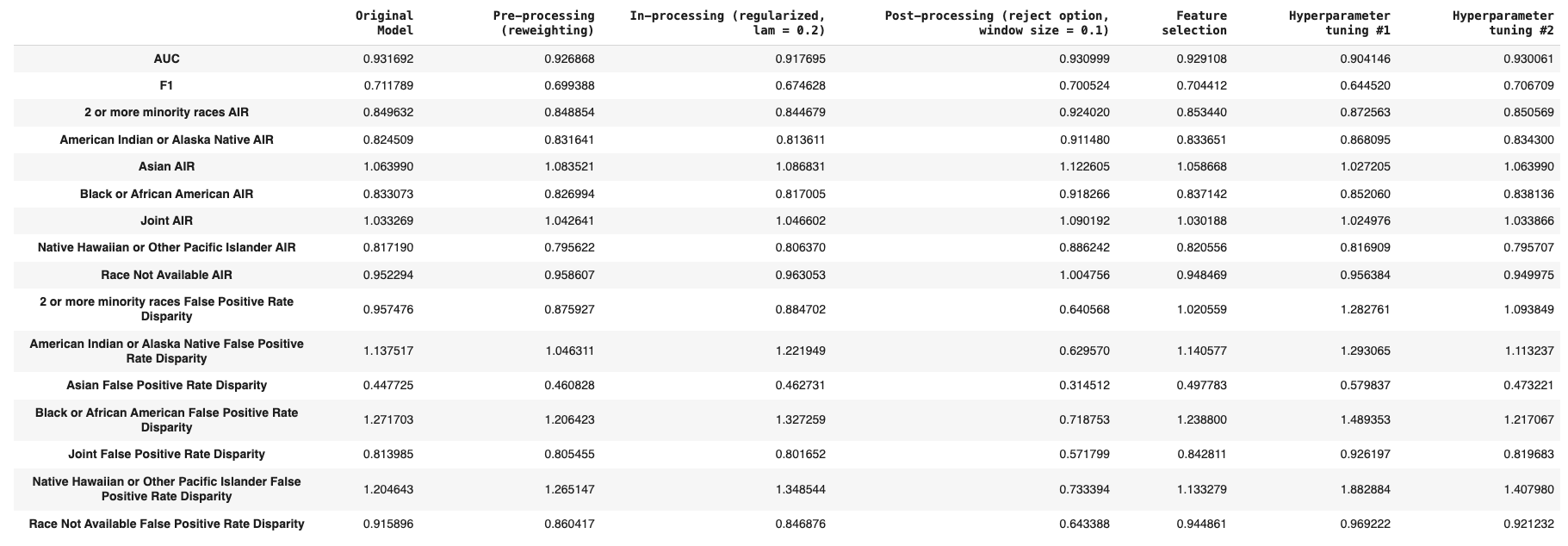
DE-BIASING TECHNIQUES – APPROVAL & DENIAL

Slide 15
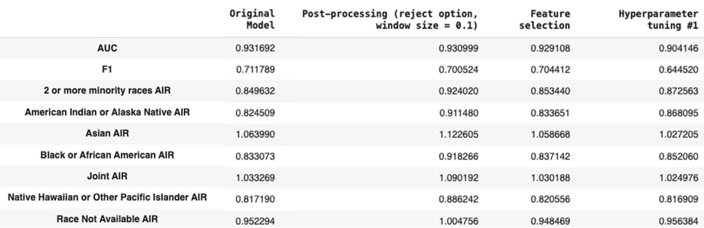
DE-BIASING TECHNIQUES – APPROVAL & DENIAL

Slide 16
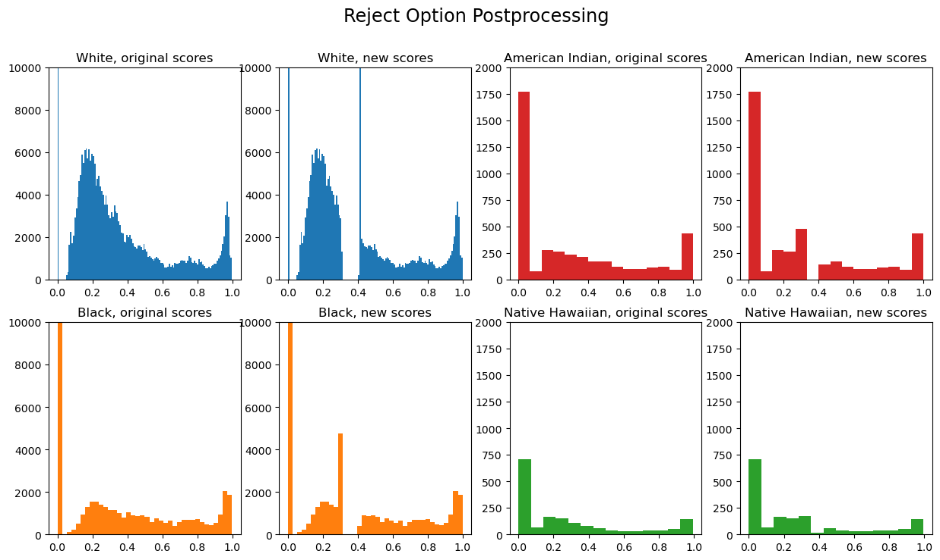
DE-BIASING TECHNIQUES – POST PROCESSING
Fig 5
AIR: 0.833 >>> 0.918

Slide 17
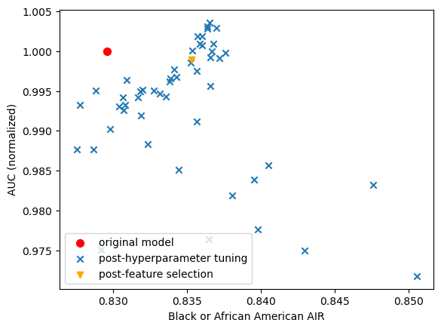
DE-BIASING TECHNIQUES – MODEL SELECTION
Model Selection:
Original Model
Feature Selection
Property value
AIR: 0.833 >>> 0.837
Hyperparameter Tuning
AIR: 0.833 >>> 0.852
Fig 6

Slide 18
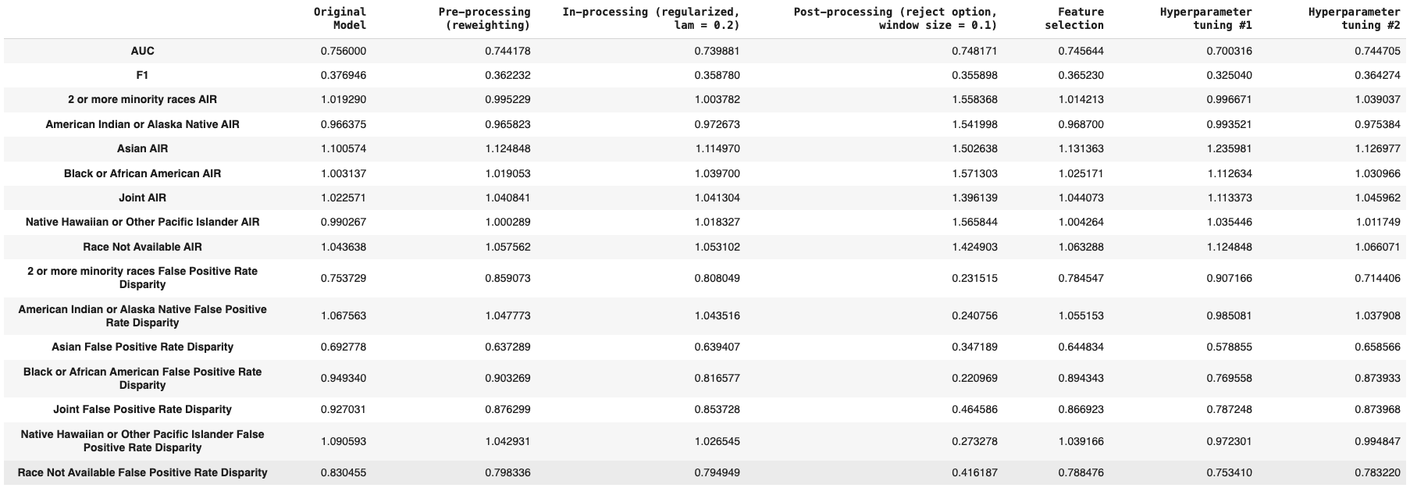
DE-BIASING TECHNIQUES – HIGH PRICED MODEL

Slide 19
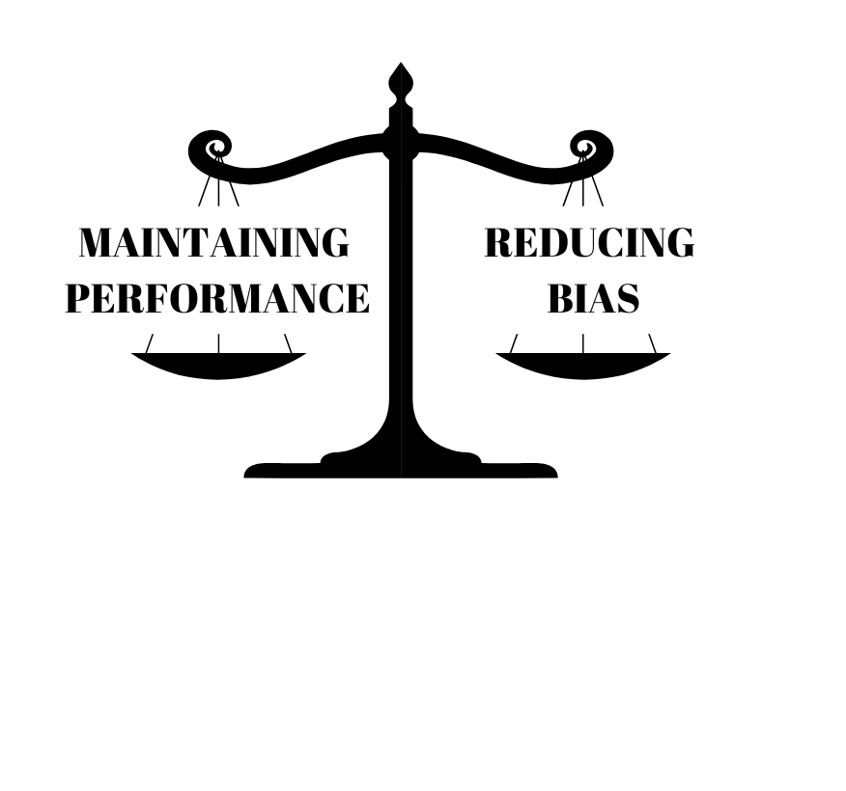
CONCLUSION – APPROVAL & DENIAL MODEL
To effectively de-bias the model with little effect on the performance, we recommend the following techniques:
Feature Selection
Enhances interpretability and improves AIR with minimal impact on performance
Hyperparameter Tuning
Better flexibility while enhancing both the AIR and the model performance

Slide 20
CONCLUSION – HIGH INTEREST LOAN MODEL
Hyperparameter Tuning is the most balanced approach to maintaining model performance while also reducing bias. It maintains AIR fairly close to 1 for most groups, does not drastically reduce AUC, and offers moderate F1 scores.

Slide 21
APPENDIX A – REFERENCES
“Home Mortgage Disclosure Act (HMDA) Data.” Consumer Financial Protection Bureau, www.consumerfinance.gov/data-research/hmda/. Accessed 10 Apr. 2024
Navy Federal Credit Union Rejected More than Half Its Black Conventional Mortgage Applicants Last Year | CNN Business, www.cnn.com/2023/12/14/business/navy-federal-credit-union-black-applicants-invs/index.html. Accessed 10 Apr. 2024.
Observations on Credit Unions’ Mortgage Lending To ..., ncua.gov/files/publications/analysis/observations-credit-unions-mortgage-lending-minority-borrowers.pdf. Accessed 11 Apr. 2024. Cortez, Valeria.
“How to Define Fairness to Detect and Prevent Discriminatory Outcomes in Machine Learning.” Medium, Towards Data Science, 8 June 2020, towardsdatascience.com/how-to-define-fairness-to-detect-and-prevent-discriminatory-outcomes-in-machine-learning-ef23fd408ef2.
Gill, N.; Hall, P.; Montgomery, K.; Schmidt, N. A Responsible Machine Learning Workflow with Focus on Interpretable Models, Post-hoc Explanation, and Discrimination Testing. Information 2020, 11, 137. https://doi.org/10.3390/info11030137
Hall, Patrick, et al. Machine Learning for High-Risk Applications Approaches to Responsible AI. O’Reilly, 2023.

Slide 22
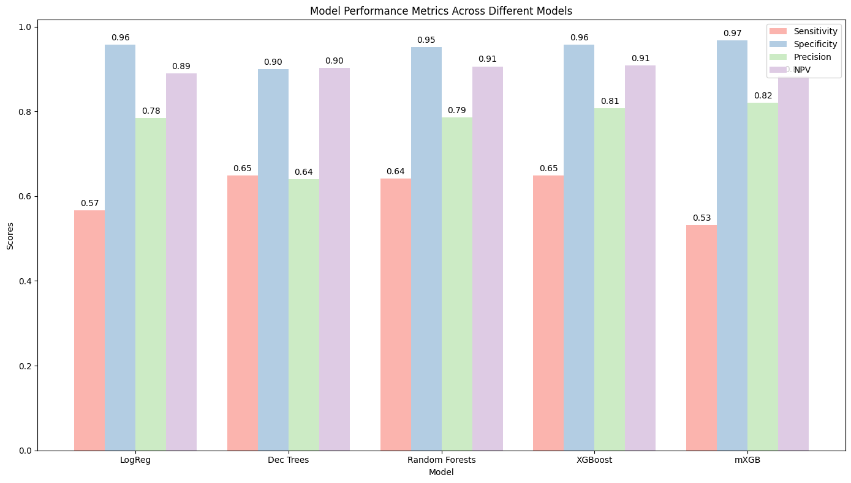
APPENDIX B – SENSITIVITY ANALYSIS (APPROVAL & DENIAL)
F1-Score: Harmonic mean of precision and recall, providing a balance between the two.
Accuracy: Measures the proportion of correctly classified cases out of all cases.
Precision: Measures the proportion of correctly identified positive cases out of all cases predicted as positive.
Recall: Measures the proportion of actual positive cases that were correctly identified by the model.
Sensitivity: Also known as True Positive Rate or Recall, measures the proportion of actual positive cases that were correctly identified by the model.
Specificity: Measures the model's ability to correctly identify negative cases. High specificity means fewer false positives.
Negative Predictive Value (NPV): Measures the proportion of correctly identified negative cases out of all cases predicted as negative.
Fig 3

Slide 23
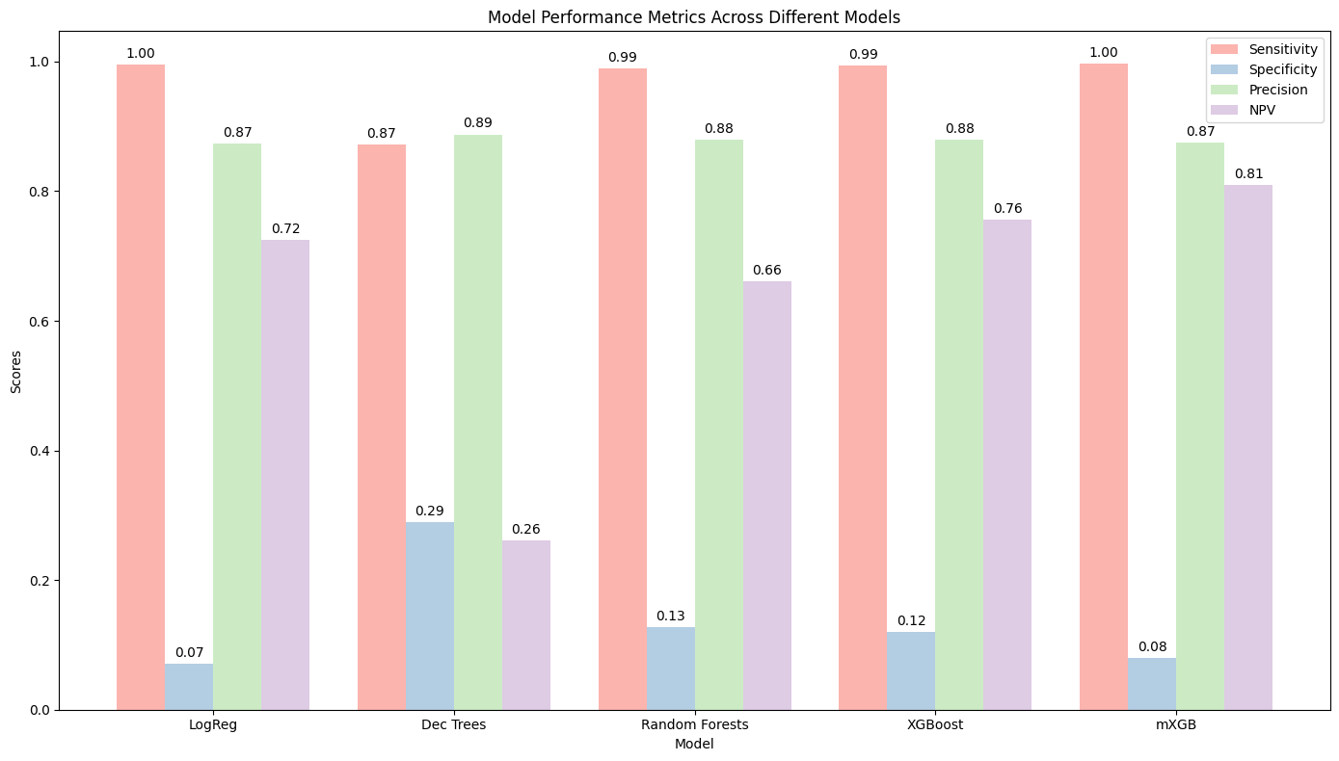
APPENDIX B – SENSITIVITY ANALYSIS (HIGH INTEREST LOAN)
Fig 6

Slide 24
APPENDIX C – CONCLUSION – APPROVAL & DENIAL MODEL
Pre-processing (reweighting): This method does not significantly affect the AUC or F1 score, but it also does not consistently improve the AIR or False Positive Rate Disparities compared to the Original Model
In-processing (regularized, λ = 0.2): While this method improves the False Positive Rate Disparity for some groups, it does not consistently improve AIR and it reduces the AUC and F1 score
Post-processing (reject option, window size = 0.1): This technique seems to significantly improve disparities in False Positive Rates for some groups, particularly the Black or African American group, but it can reduce the AUC and F1 score
Feature selection: This approach maintains a relatively high AUC and improves the AIR for most groups, indicating a good balance of performance and fairness. However, it increases the False Positive Rate Disparity for some groups.
Hyperparameter tuning #1: This method generally maintains or improves the AIR scores but at the cost of decreased AUC and F1 scores
Hyperparameter tuning #2: This approach shows good AIR values for most groups and a relatively high AUC, but the F1 score is reduced, and there's a mixed result on the False Positive Rate Disparity
Looking at the balance between maintaining performance and reducing bias, both feature selection and hyperparameter tuning performed well.
Feature selection: Enhances interpretability and improves AIR with minimal impact on AUC.
Hyperparameter tuning: Greater flexibility, Maximize AIR, or Enhance both AIR and AUC.

Slide 25
APPENDIX C – CONCLUSION – HIGH INTEREST LOAN MODEL
Pre-processing (reweighting): has a moderate impact on reducing bias according to the AIR and False Positive Rate Disparity but also reduces the AUC and F1 scores slightly.
In-processing (regularized, λ = 0.2): generally maintains the AIR close to 1 but increases the disparity in some cases, such as for Asian AIR and Black or African American AIR. It also leads to a reduction in AUC and F1.
Post-processing (reject option, window size = 0.1): drastically reduces False Positive Rate Disparity across almost all groups, which is a significant improvement in fairness. However, it also results in a considerable decrease in both AUC and F1 scores.
Feature selection: somewhat maintains AUC and shows a slight improvement in F1 scores compared to most other techniques. It also provides fair AIR across groups but has mixed effects on False Positive Rate Disparity.
Hyperparameter tuning #1: generally maintains or slightly improves AIR and also improves the False Positive Rate Disparity for some groups. However, there is a reduction in AUC, and it is not consistent in improving the F1 score.
Hyperparameter tuning #2: provides reasonable AIR values with some improvement over the original model, a relatively small reduction in AUC, and a moderate decrease in F1 score. It also shows mixed results in terms of False Positive Rate Disparity.
Given these results, if the priority is to maintain model performance while also reducing bias, hyperparameter tuning might be the most balanced approach as it maintains AIR fairly close to 1 for most groups, does not drastically reduce AUC, and offers moderate F1 scores.

Slide 26
Thank you!

